Slide 1

Design and Development of an Intelligent Personal Finance Management System with AI-Driven Expense Analytics and Budget Optimization
CSA4303 - INTERNET PROGRAMMING
SUPERVISOR
Dr. N.Marie claude
PRESENTED BY Sairaj C-(192411018)
Alan Aldrin EA-(192411023)
Aravind Kumar Reddy-192324225

Slide 2



Introduction
A Smart Digital Wallet helps users manage financial transactions digitally.
Tracks income and expenses in real time.
Provides budget monitoring and financial insights.
Designed using Object-Oriented principles for modularity and scalability.

Slide 3
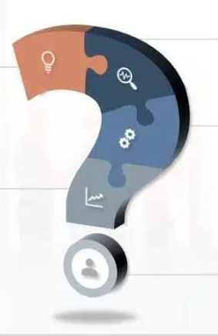
Problem Statement
Users perform multiple daily financial transactions that are difficult to track manually.
Existing systems lack proper expense monitoring and budget analysis.
Users face challenges in categorizing expenses and controlling overspending.
There is a need for real-time financial insights and alert mechanisms.
A Smart Digital Wallet using Object-Oriented design is required for secure, modular and efficient financial management.

Slide 4
Existing Work
Traditional wallets and banking apps mainly focus on transactions and payments.
Expense tracking apps provide limited budget analysis and customization.
Most systems lack integrated financial analytics and real-time alerts.
Many existing solutions are not designed using a fully modular object-oriented approach.

Slide 5
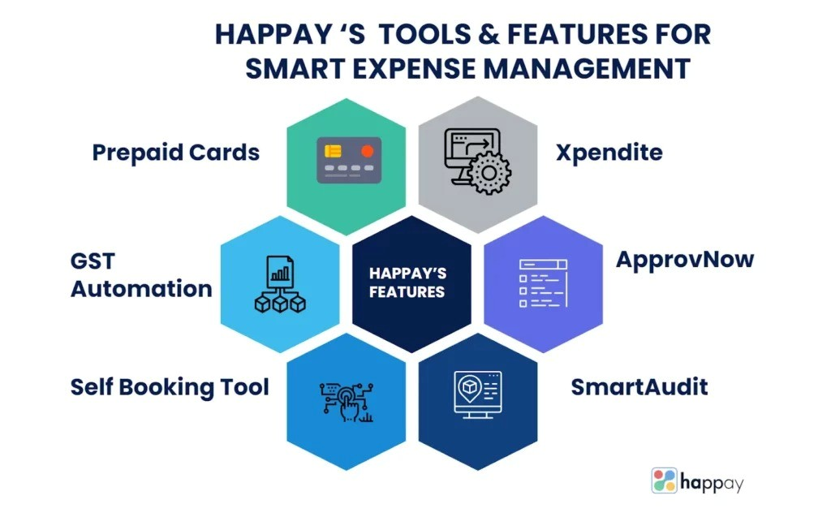
Proposed System
The proposed system is a Smart Digital Wallet that securely manages user’s transactions.
It automatically tracks and categorizes expenses in real time.
The system provides budget planning and detailed financial analytics.
Timely notifications and alerts help users control spending.
Object-Oriented design ensures modularity, scalability, and easy maintenance.

Slide 6
Implementation
The system is implemented using Object-Oriented programming principles.
Each module is developed as independent classes and packages.
Secure authentication and transaction handling are enforced.
Expense tracking, budgeting, and analytics are integrated through business logic.
The modular design allows easy upgrades and future enhancements.

Slide 7
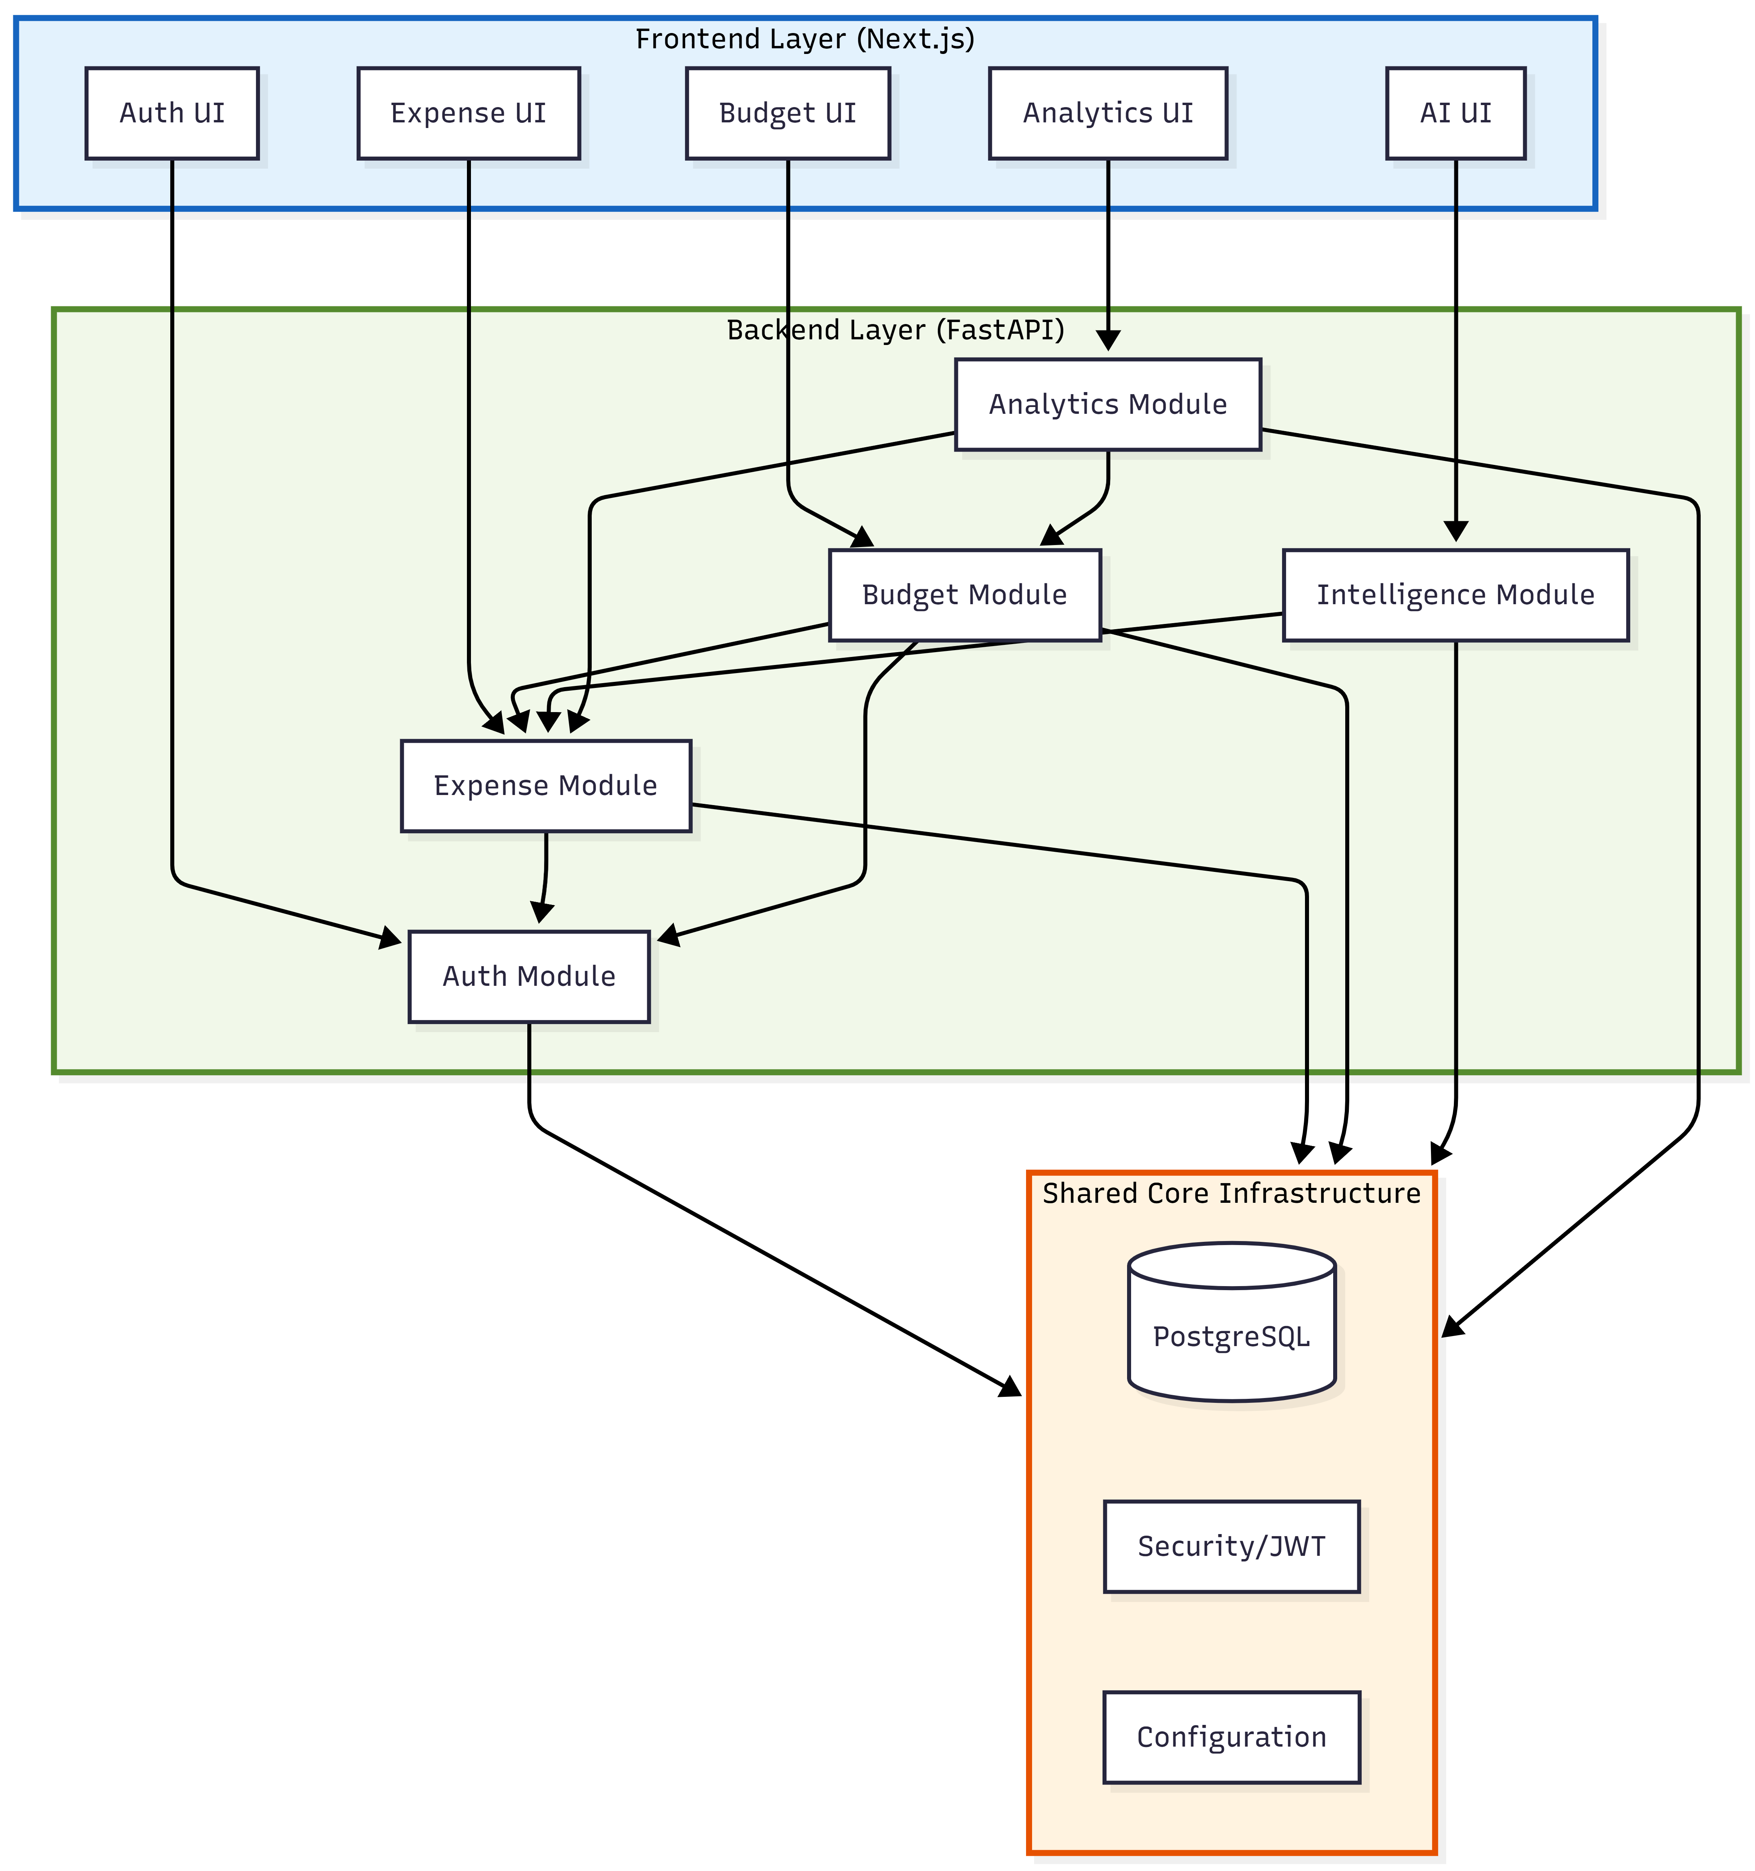
System Architecture
System Architecture

Slide 8
Module 1: Authentication & User Management
Responsibility: User identity, security, and session management
Key Components :
User registration and login
JWT token generation and validation
Password security (bcrypt)
User profile CRUD
Session management

Slide 9
Module 2: Expense Management
Responsibility: Transaction tracking and categorization
Key Components:
Expense CRUD operations
Category management
Transaction import from payment platforms
Expense filtering and search
Multi-platform data normalization

Slide 10
Module 3: AI/ML Intelligence Services
Responsibility: Intelligent automation and predictions
Key Components:
Automatic expense categorization (NLP)
Predictive budget planning (ARIMA/LSTM)
Fraud and anomaly detection
Smart spending recommendations

Slide 11
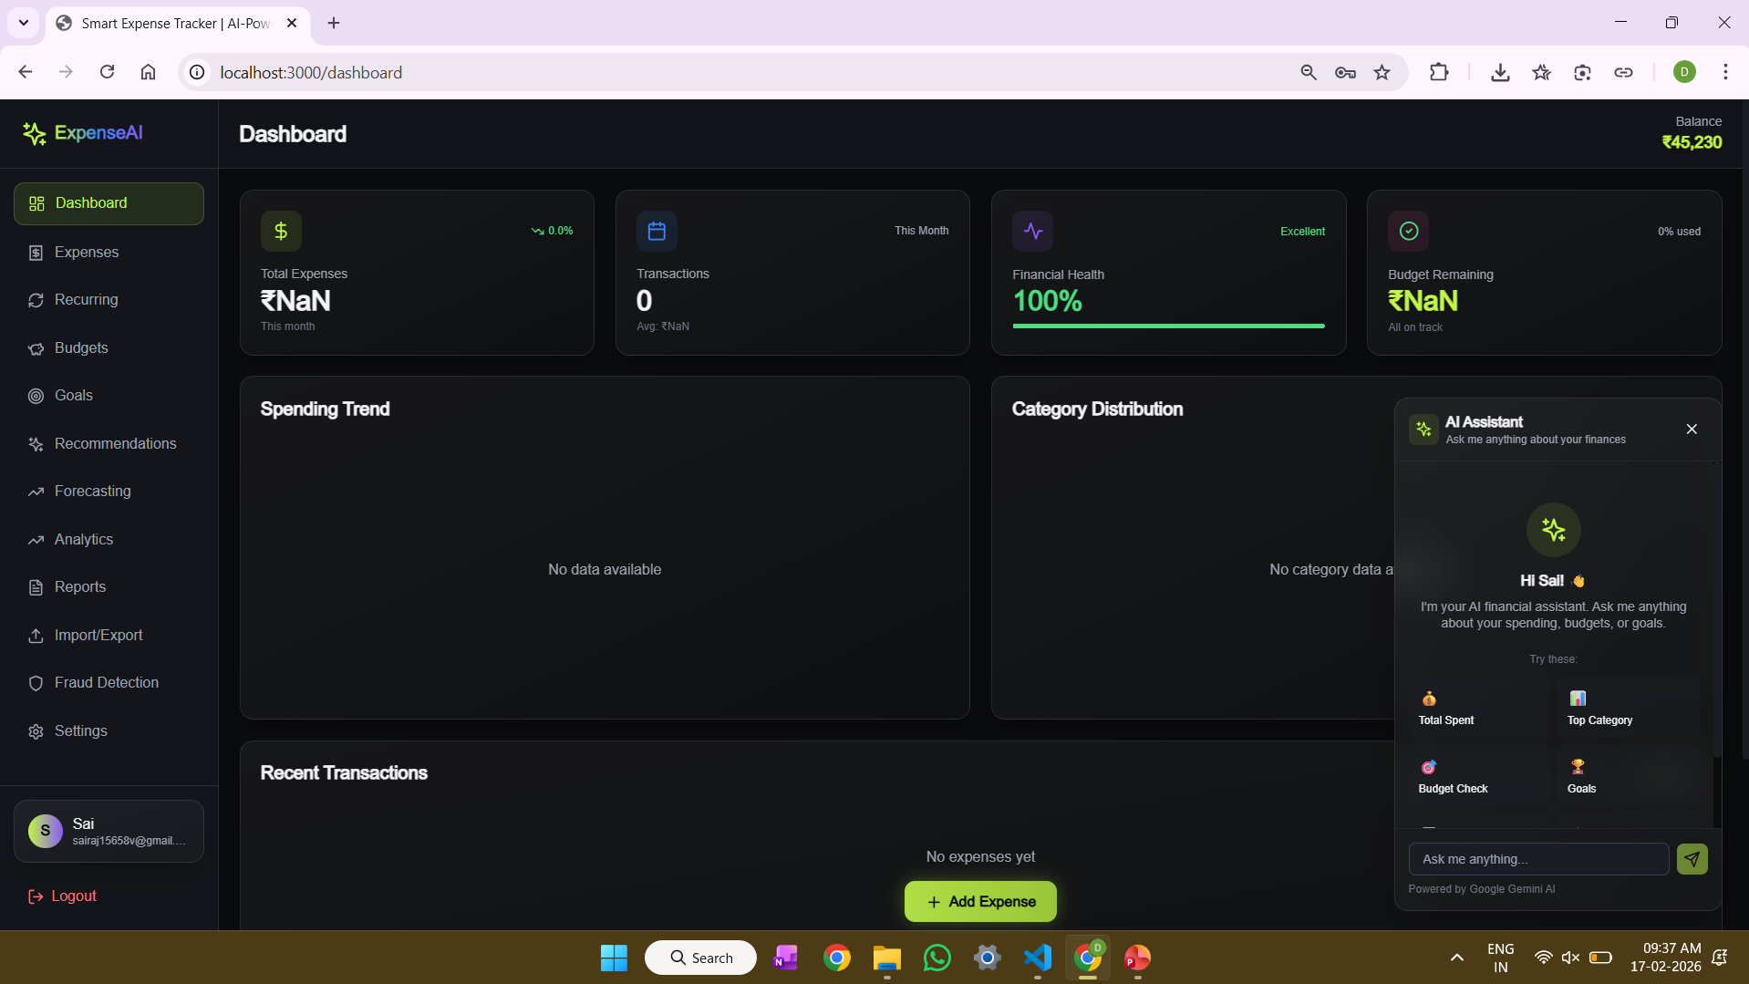
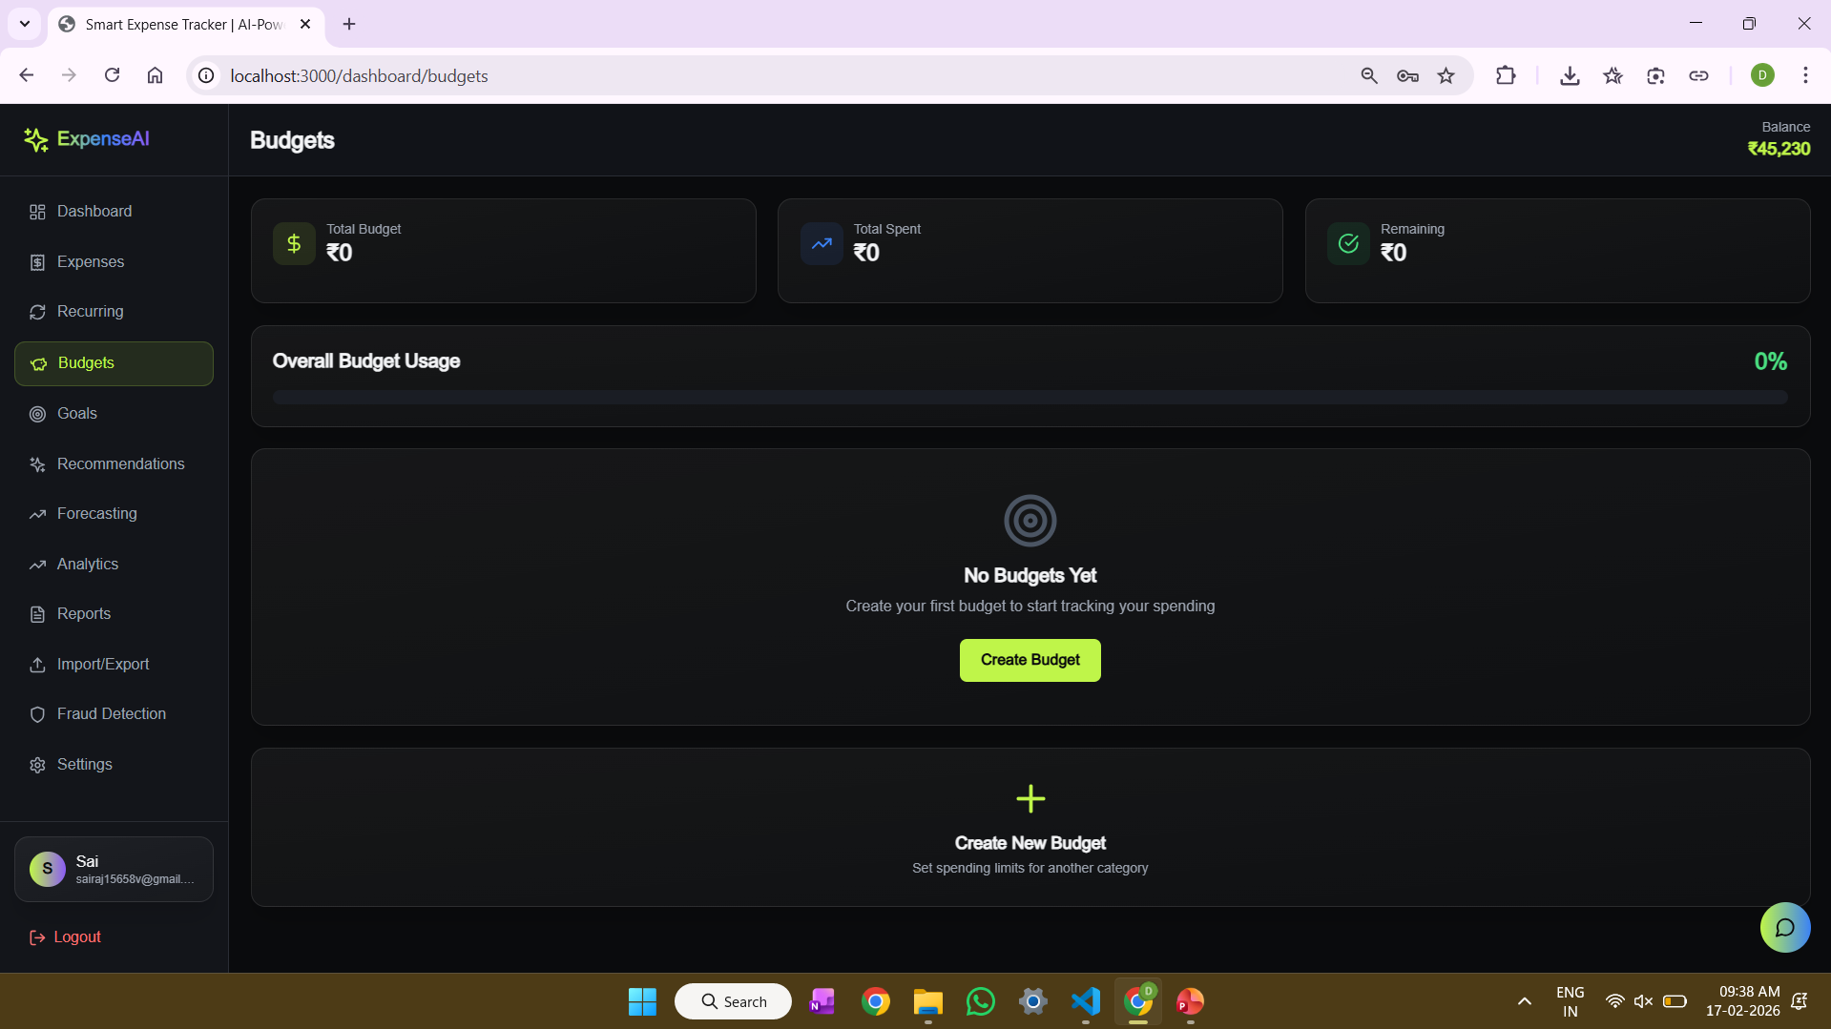
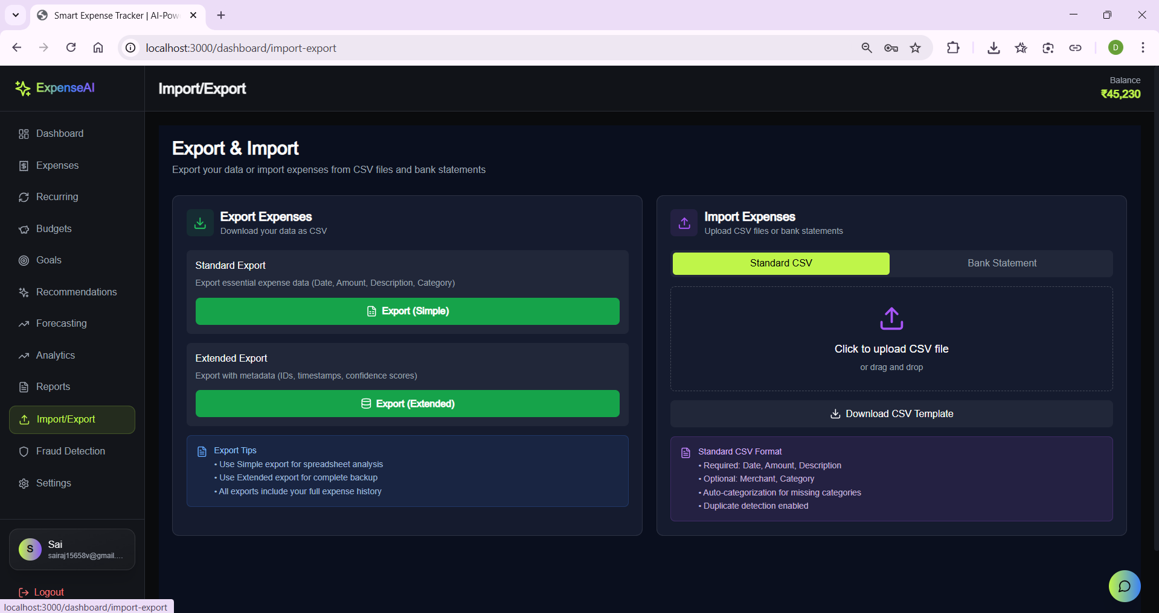
Output

Slide 12
Engineering Standards
Software Quality and Reliability Standards: The system is developed following software quality standards such as correctness, reliability, usability, and maintainability.
Security and Data Protection Standards: The application follows security engineering standards to protect sensitive user data.
Coding and Documentation Standards: Standard coding practices are followed, including proper naming conventions, modular programming, and in-code documentation.
Performance and Scalability Standards: The system is designed to handle multiple users and large volumes of transaction data efficiently.

Slide 13
Conclusion
The Smart Digital Wallet provides an efficient solution for managing digital financial transactions.
It enables real-time expense tracking and effective budget analysis.
Object-Oriented design improves system modularity, security, and scalability, the notification system helps users control spending and avoid overspending.
Overall, the system enhances personal financial management and decision-making.

Slide 14
References
Sommerville, I. (2016). Software engineering (10th ed.). Pearson Education.
Pressman, R. S., & Maxim, B. R. (2020). Software engineering: A practitioner’s approach (9th ed.). McGraw-Hill Education.
Booch, G., Rumbaugh, J., & Jacobson, I. (2005). The unified modeling language user guide (2nd ed.). Addison-Wesley.
Gamma, E., Helm, R., Johnson, R., & Vlissides, J. (1994). Design patterns: Elements of reusable object-oriented software. Addison-Wesley.
Meyer, B. (2000). Object-oriented software construction (2nd ed.). Prentice Hall.
Fowler, M. (2020).Patterns of Enterprise Application Architecture.Addison-Wesley.
Davenport, T. H., & Ronanki, R. (2020).Artificial Intelligence for the Real World.Harvard Business Review.
Sommerville, I. (2020).Software Engineering (10th International Edition).Pearson Education.

Slide 15
Thank you

